Slide 1
Enabling your DevOps Process through Azure
Alec Deitz

Slide 2
Agenda
Brief DevOps Overview
Azure DevOps
Azure App Services
ARM Templates
Azure CLI
Microservices
Other Services

Slide 3
What is DevOps?

Slide 4
What is DevOps?
Business
Development
QA
Operations
Deliver Features
No Production Defects
No Production Incidents/Downtime
Notes:
Traditional org structure used in managing software projects
Can anyone see the problem? - All 3 have individual goals, not team goals

Slide 5
What is DevOps?
Business
Development
QA
Operations
Deliver Features &
No Production Defects &
No Production Incidents/Downtime
High-performing team
Notes:
Everyone works together toward all aspects of successful product delivery
Wear multiple hats
Central goal: Delighting Customers

Slide 6
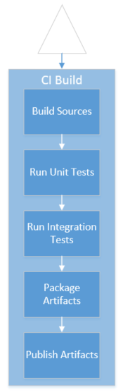
Continuous Delivery
Continuous Integration (prerequisite)
“… a software development practice where members of a team integrate their work frequently, usually each person integrates at least daily - leading to multiple integrations per day. Each integration is verified by an automated build (including test) to detect integration errors as quickly as possible.”
https://martinfowler.com/articles/continuousIntegration.html
Notes:
Continuous integration is too frequently confused with automated build
It is easy and common to have an automated build but NOT practice CI:
Long-lived feature branches
Infrequent merges into main/master/trunk
With the right testing, best measure of state of the system after your change
(and the changes of your peers!)

Slide 7

Continuous Delivery
Delivery Pipeline
Run on every change that may impact the system
Infrastructure as Code
Configuration as Code
Data as Code
Validation via Tests
Notes:
Key pattern in Continuous Delivery, talk about what a pipeline is before getting into run on every change
Data as Code too
Give use case (insurance discount table load)
Does not apply to “data processing”
Pertains to data that is inextricable tied to the business logic (tax tables, pricing rules)
Automated gets you as close to guaranteed results as is practical
Predictability in delivery process
Repeatability in delivery process

Slide 8
Azure DevOps

Slide 9

Azure DevOps
Cloud offering of TFS (Azure DevOps Server)
One stop shop for DevOps
Backlogs
Testing
Build/Release
Generate pipeline from App Service

Slide 10

Azure DevOps
Live Demo!

Slide 11
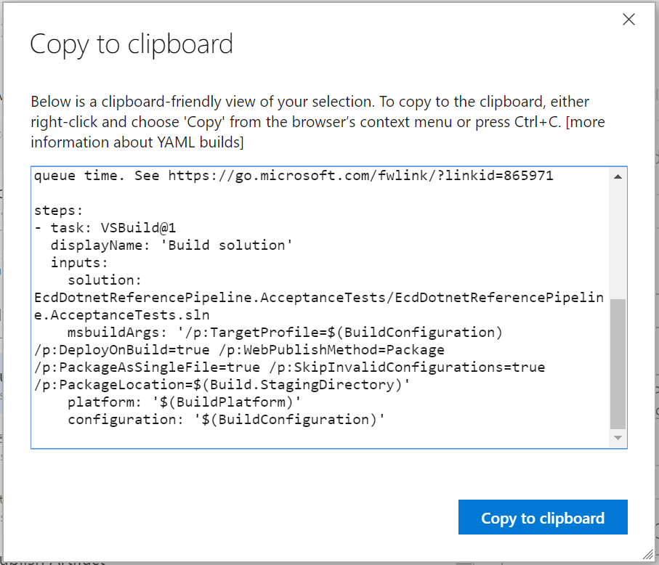
YAML Builds

Slide 12
ARM Templates

Slide 13
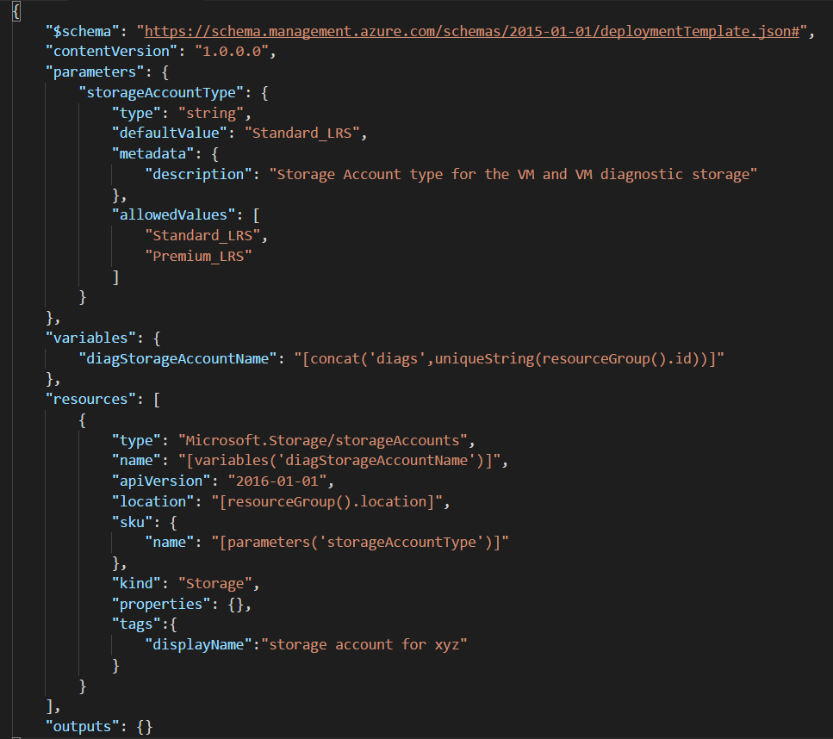
ARM Templates
Azure Resource Manager
Version infrastructure
Script environment
Run in pipelines!

Slide 14
ARM Templates
Demo!

Slide 15
Azure CLI
Manage Azure resources from command line
Create resource groups
Create resources
Deploy to an app service
Spin up a database
Etc.
SCRIPT EVERYTHING

Slide 16
Azure CLI
Demo!

Slide 17
Microservices

Slide 18
Microservice Architecture
Get away from monolithic approach
Apps broken up into small granular services
Deployed individually
Deployed frequently
Backed by individual data stores
Low-risk deployments

Slide 19
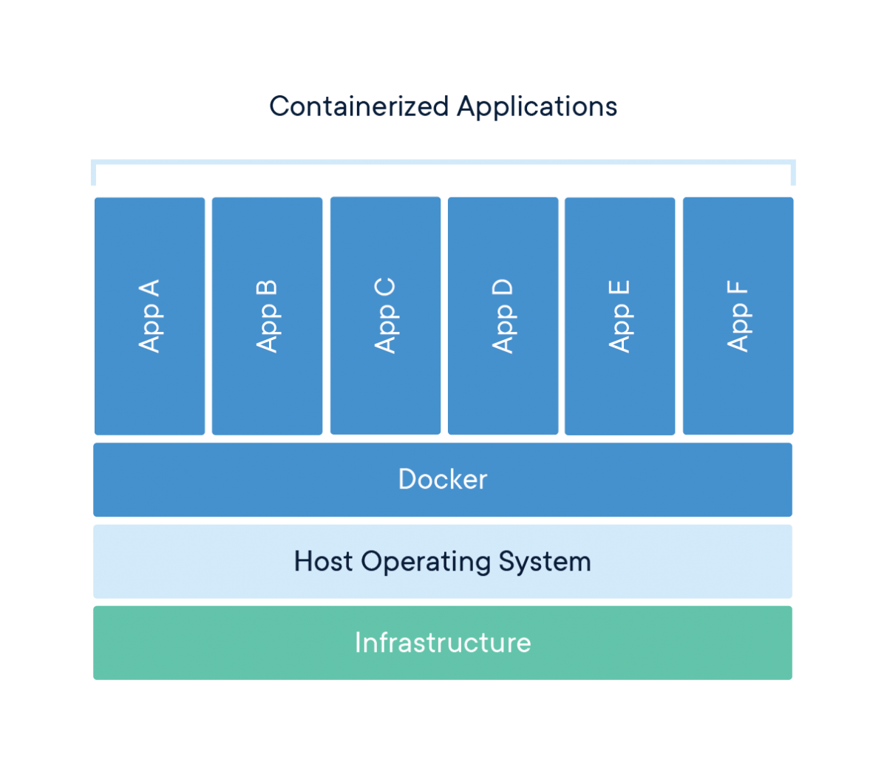
Containers
Packaged code and dependencies
Images share machine’s OS system kernel
Docker
Linux or Windows

Slide 20
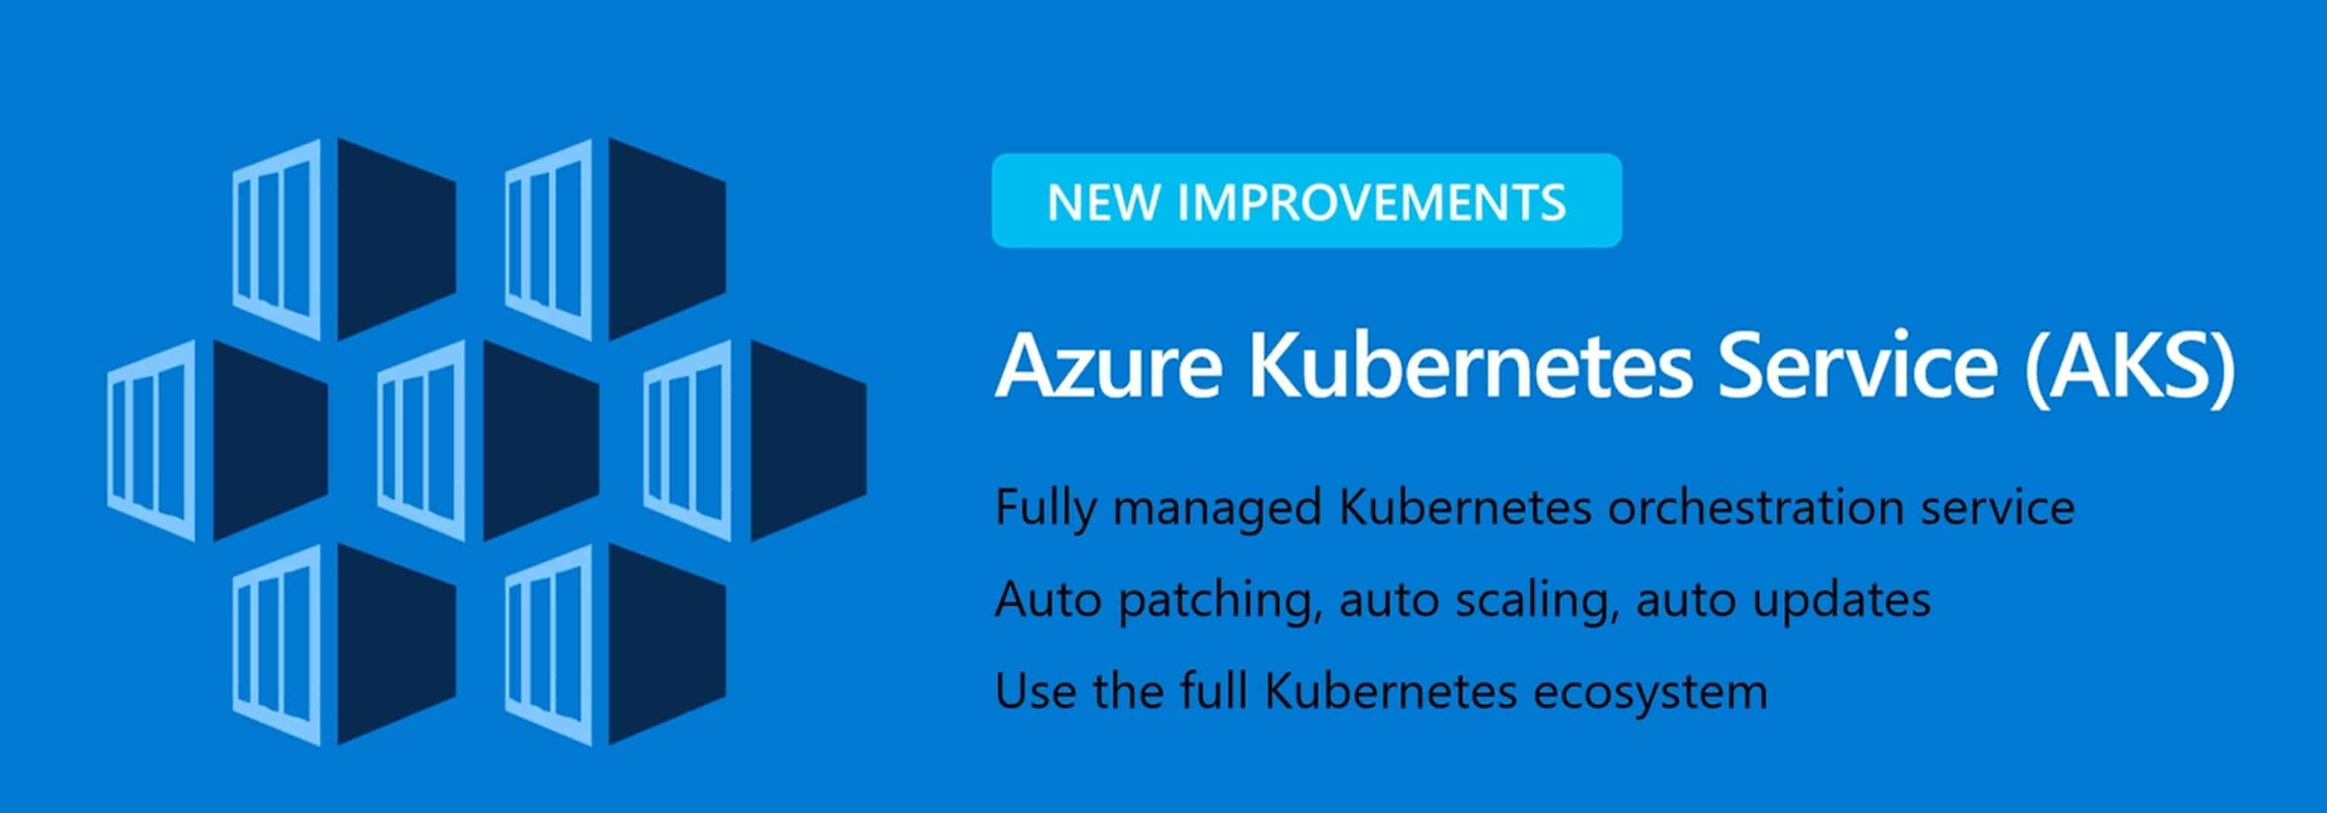
Azure Kubernetes Services
Kubernetes hosted in Azure
Container orchestrator
Runs Docker
Worry about development, not maintenance

Slide 21
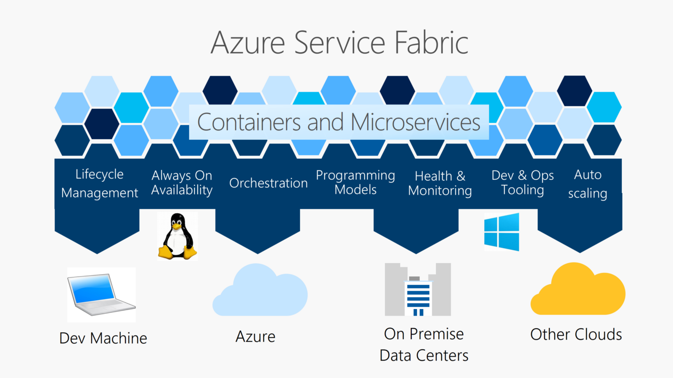
Azure Service Fabric

Slide 22
Other Services
Azure Key Vault
Application Insights
Azure Cosmos DB
Azure Functions

